Slide 1
Python
Session -6

Slide 2
Python range() function
It generates a list of numbers which is generally used to iterate over with for loops.
The range function has two sets of parameters
range(stop)
range([start], stop[, step])
Start: Starting number of the sequence
Stop: Generate numbers up to, but not including this number
Step: Difference between each number in the sequence

Slide 3
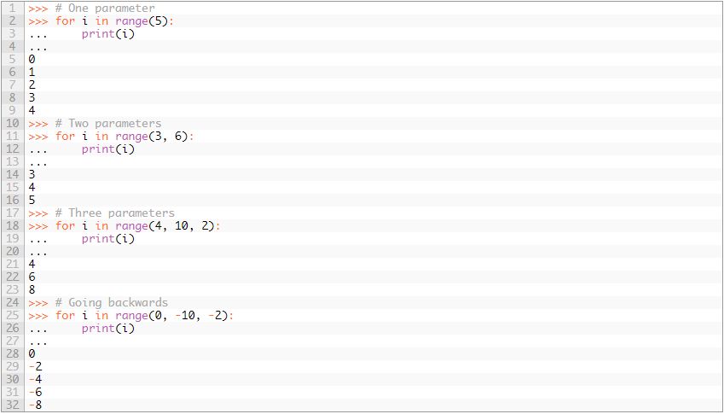

Slide 4
Time
There is a popular time module available in Python which provides functions for working with times, and for converting between representations. The function time.time() returns the current system time in ticks since 12:00am, January 1, 1970(epoch).
import time; # This is required to include time module.
ticks = time.time()
print ("Number of ticks since 12:00am, January 1, 1970:", ticks)
print (time.localtime())

Slide 5
Calendar
The calendar module gives a wide range of methods to play with yearly and monthly calendars.
import calendar
cal = calendar.month(2016, 2)
print ("Here is the calendar:")
print (cal)

Slide 6
Functions
A function is a block of organized, reusable code that is used to perform a single, related action. Functions provide better modularity for your application and a high degree of code reusing.
user-defined functions.
You can define functions to provide the required functionality. Here are simple rules to define a function in Python.
Function blocks begin with the keyword def followed by the function name and parentheses ( ( ) ).
Any input parameters or arguments should be placed within these parentheses. You can also define parameters inside these parentheses.
The first statement of a function can be an optional statement - the documentation string of the function or docstring.
The code block within every function starts with a colon (:) and is indented.
The statement return [expression] exits a function, optionally passing back an expression to the caller. A return statement with no arguments is the same as return None.

Slide 7
Function cont…
def userDefFunction (arg1, arg2, arg3 ...):
program statement1
program statement3
program statement3
....
return

Slide 8
Return
The statement return [expression] exits a function, optionally passing back an expression to the caller. A return statement with no arguments is the same as return None.
# Function definition is here
def sum( arg1, arg2 ):
# Add both the parameters and return them."
total = arg1 + arg2
print ("Inside the function : ", total)
return total
# Now you can call sum function
total = sum( 10, 20 )
print ("Outside the function : ", total )

Slide 9
Ex.
def defArgFunc( empname, emprole = "Manager" ):
print ("Emp Name: ", empname)
print ("Emp Role ", emprole)
return;
print("Using default value")
defArgFunc(empname="Nick")
print("************************")
print("Overwriting default value")
defArgFunc(empname="Tom",emprole = "CEO")

Slide 10
Calling a Function
Recursion is a way of programming or coding a problem, in which a function calls itself one or more times in its body. Usually, it is returning the return value of this function call.
def factorial(n):
if n == 1:
return 1
else:
return n * factorial(n-1)

Slide 11
PIP is a package manager for Python that uses the Python Package Index to install Python packages. PIP will later be used to install Django from PyPI. If you’ve installed Python 3.4, pip is included so you may skip this section.
Django can be installed easily using pip.
In the command prompt, execute the following command: pip install django. This will download and install Django.
After the installation has completed, you can verify your Django installation by executing django-admin.py --version in the command prompt.

Slide 12
Ex- 1
Design a calculator which does the following:
Asks the user for the option
#Print what options you have
print Option 1 - add
print Option 2 - subtract
print Option 3 - multiply
print Option 4 - divide
print Option 5 - quit program
Then performs the operations selected by the user

Slide 13
#calculator program
#this variable tells the loop whether it should loop or not.
# 1 means loop. anything else means don't loop.
loop = 1
#this variable holds the user's choice in the menu:
choice = 0
while loop == 1:
#print what options you have
print "Welcome to calculator.py"
print "your options are:"
print " "
print "1) Addition"
print "2) Subtraction"
print "3) Multiplication"
print "4) Division"
print "5) Quit calculator.py"
print " "
choice = input("Choose your option: ")
if choice == 1:
add1 = input("Add this: ")
add2 = input("to this: ")
print add1, "+", add2, "=", add1 + add2
elif choice == 2:
sub2 = input("Subtract this: ")
sub1 = input("from this: ")
print sub1, "-", sub2, "=", sub1 - sub2
elif choice == 3:
mul1 = input("Multiply this: ")
mul2 = input("with this: ")
print mul1, "*", mul2, "=", mul1 * mul2
elif choice == 4:
div1 = input("Divide this: ")
div2 = input("by this: ")
print div1, "/", div2, "=", div1 / div2
elif choice == 5:
loop = 0
print "Thankyou for using calculator.py!"

